Slide 1
SWOT ANALYSIS
NETFLIX

Slide 2

Summarize your platform's current state using SWOT framework
Strengths
Observation Netflix has a large number of movies and TV shows and a wide variety of genres on the platform.
Evidence The Movie vs TV bar chart shows a large volume of titles, and the genre mix chart shows strong representation across multiple genres such as drama, comedy, reality, and documentary.
Strategic Implication This large and diverse catalog allows Netflix to attract a broad audience and maintain strong viewer engagement.
Weaknesses
Observation Netflix’s content catalog is dominated by movies, while TV shows represent a smaller portion of the platform’s library.
Evidence The Movie vs TV bar chart shows that movies make up a significantly larger share of the catalog compared to TV shows.
Risk Implication Since TV series typically drive longer viewing time and subscriber retention, this imbalance could limit long-term engagement if users prefer serialized content.
Opportunities
Market gap observed:
Some niche genres such as documentaries and international content appear less represented compared to dominant genres like drama and comedy.
Supporting data:
The IMDb score distribution shows most titles around the 6–7 range.
Strategic opportunity:
Netflix could expand investment in niche and international genres to attract new audience segments and further diversify its content offering.
Threats
Competitive signal observed:
Netflix shows a relatively wide distribution of scores, including numerous low-score outliers.
Evidence from comparison:
The Rotten Tomatoes score distribution (box plot) shows a wider spread of scores for Netflix, with several lower-rated outliers.
Strategic risk:
This could lead to inconsistent user experience and potential reputational dilution if low-quality content reduces overall platform perception.

Slide 3
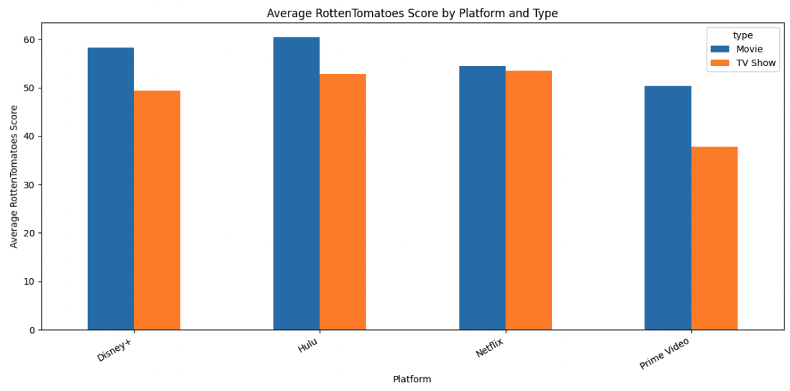
Summarize your platform's current state using SWOT framework
Strengths
Observation:
Netflix has a large number of movies and TV shows and a wide variety of genres on the platform.
Evidence
Bar chart
Strategic implication
This large and diverse catalog allows Netflix to attract a broad audience and maintain strong viewer engagement.

Slide 4
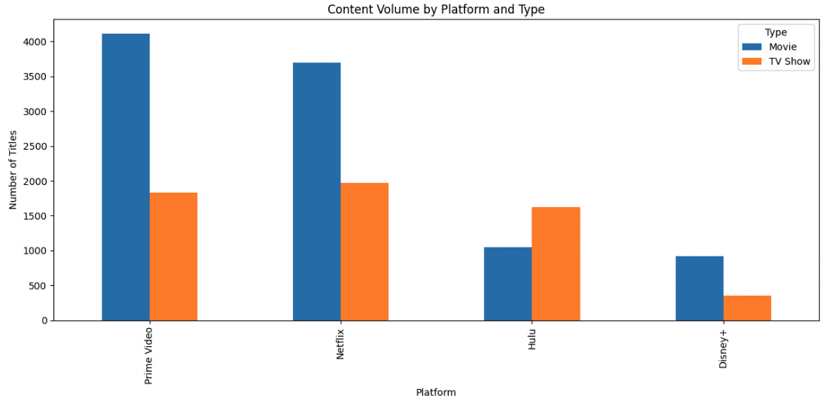
Summarize your platform's current state using SWOT framework
Weaknesses
Observation:
Netflix’s content catalog is dominated by movies, while TV shows represent a smaller portion of the platform’s library.
Evidence
Below bar chart
Strategic implication
Since TV series typically drive longer viewing time and subscriber retention, this imbalance could limit long-term engagement if users prefer serialized content.

Slide 5
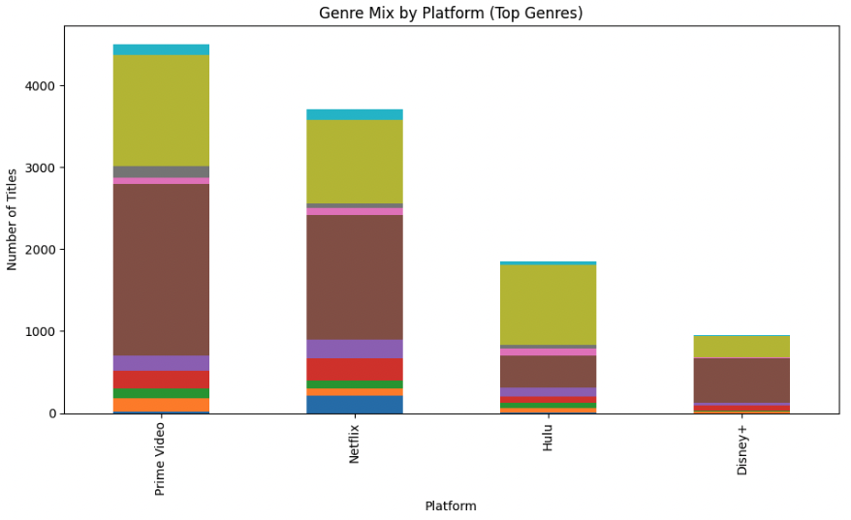
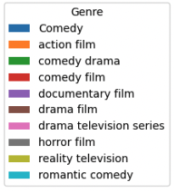
Summarize your platform's current state using SWOT framework
Opportunities
Market gap observed: Some genres like documentaries and niche international content appear less represented in Netflix’s genre mix compared to its dominant genres like drama and comedy.
Supporting data
Stacked bar chart
Strategic opportunity:
Netflix could invest more in niche genres such as documentaries or regional/international content to attract new audiences and further diversify its catalog.

Slide 6
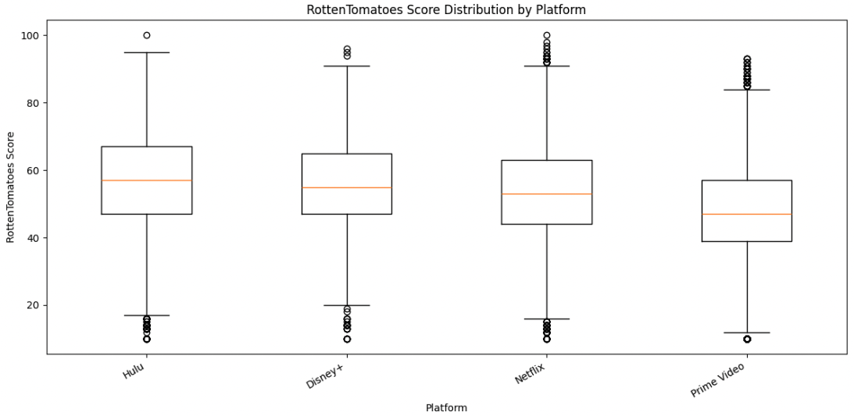
Summarize your platform's current state using SWOT framework
Threats
Competitive signal observed
Netflix shows a relatively wide distribution of scores, including numerous low-score outliers.
Supporting data
Below box plot
Strategic opportunity:
This could lead to inconsistent user experience and potential reputational dilution if low-quality content reduces overall platform perception.

Slide 7
Strategic recommendation from SWOT analysis
Based on the SWOT analysis, Netflix should continue expanding its diverse content library while investing more in niche and international genres. This recommendation is supported by the genre mix chart and the large number of titles shown in the platform distribution and release year charts. The expected outcome would be higher viewer engagement and the ability to attract a wider global audience.
Notes:
Which force is strongest in streaming today?
Which force can data help us observe indirectly?

